Slide 1


SMART_AGAKESI
Digital Savings Solution for Rwandans
Deo MUHIRE

Slide 2
Introduction
In Rwanda, the traditional savings culture lacks structured methods. Many Rwandans use the Agakesi, a wooden box priced at 500 RWF, to save money. However, it is not secure and offers no flexibility.

Slide 3
traditional AGAKESI’

Slide 4
Problem
The traditional Agakesi is both expensive and insecure. It doesn’t support modern savings needs, leaving a gap in the financial ecosystem for safe, convenient, and structured savings.

Slide 5
solution
SMART_AGAKESI is a mobile-based saving platform designed to replicate the
traditional Agakesi savings method in a digital format. It offers two saving options:
.2- month plan priced 200frw and
. 4-month plan priced 300frw.
Users can access SMART_AGAKESI via USSD for button phone users or through a dedicated mobile Application for smartphone users. and tracks saving history
BIKA SMART
https://agakesi.vercel.app/

Slide 6
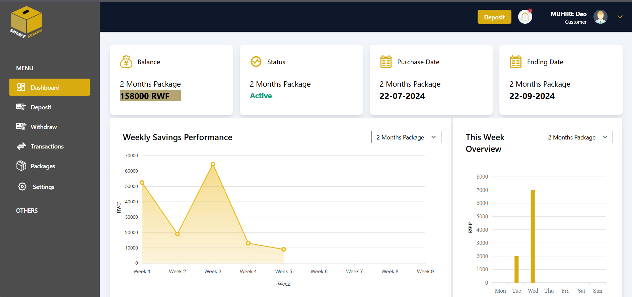

Slide 7



Size the market
10 Million
Total Available
Market (TAM)
over 10 million registered users. Mobile money services like MTN MoMo and Airtel Money
6 M
Serviceable Available
Market (SAM)
2.5M
Serviceable Obtainable
Market (SOM)

Slide 8

business model
1.sell SMARTAGAKESI
2.savings managment
Revenue Streams:
3.loan services

Slide 9
Gross profit
Subscribers 2,500,000 subs | Amount/subs 300 x 1.5M 200 x 1M | Amount/Q1 Amount/year frw 450M 450 x 3= 1.350b frw 200M 200 x 4= 800M
 |  | frw 2.150b

Slide 10
competitors
1. IKIMINA CYACU (Prime Life Insurence)
2. MOCASH (MTN)

Slide 11
1.Cultural Relevance
2.Affordability
3.Security and Safety
4.Convenience and Accessibility: via USSD and web app
Competitive Advantage
5. loan services

Slide 12
Contact
+250786265192
deomuhire100@gmail.com
www.linkedin.com/in/deo-muhire/
DEO MUHIRE

